Slide 1
Mount Auburn Community Learning Session
Sustainability
Jennifer Lenoci-Edwards
Director, Patient Safety

Slide 2
Objectives
Introduce and develop a common understanding of the Framework for Safe, Reliable and Effective Care
Discuss where your new improvement skill has opportunities to fail and discuss how we might mitigate those barriers

Slide 3
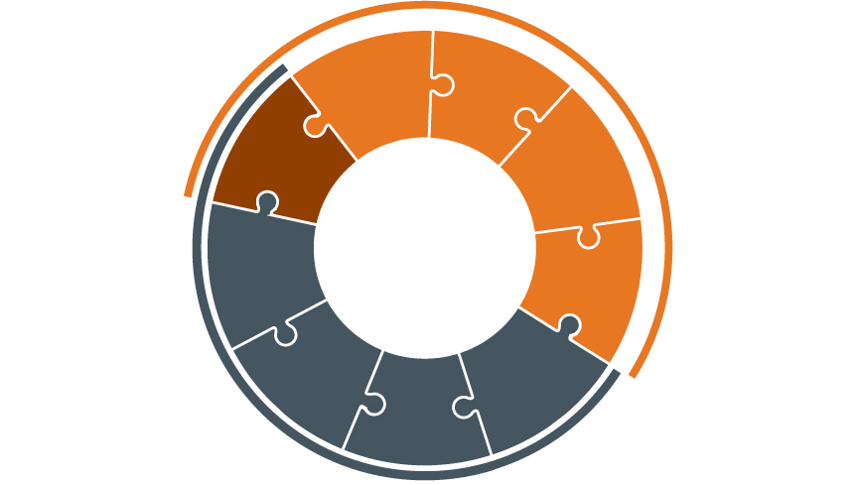
Framework for Safe, Reliable and Effective Care
Culture
Psychological Safety
Accountability
Leadership
Teamwork &
Communication
Engagement of Patients & Family
Transparency
Negotiation
Reliability
Continuous Learning
Improvement
&
Measurement
Learning System
© IHI and Allan Frankel

Slide 4

Framework for Safe, Reliable and Effective Care
Creating an environment where people feel comfortable and have opportunities to raise concerns or ask questions.
Being held to act in a safe and respectful manner given the training and support to do so.
Psychological Safety
Accountability
Facilitating and mentoring teamwork, improvement, respect and psychological safety.
Developing a shared understanding, anticipation of needs and problems, agreed methods to manage these as well as conflict situations
Leadership
Teamwork &
Communication
Engagement of Patients & Family
Openly sharing data and other information concerning safe, respectful and reliable care with staff and partners and families.
Transparency
Gaining genuine agreement on matters of importance to team members, patients and families.
Negotiation
Reliability
Continuous Learning
Improvement
&
Measurement
Applying best evidence and minimizing non-patient specific variation with the goal of failure free operation over time.
Regularly collecting and learning from defects and successes.
Improving work processes and patient outcomes using standard improvement tools including measurements over time.
© IHI and Allan Frankel

Slide 5

How it works in real life
Framework for Safe, Reliable and Effective Care
Culture
Leadership
Continuous Learning
Psychological Safety
Improvement and Measurement
Learning System
Accountability
Reliability
Teamwork and Communication
Transparency
Negotiation
© IHI and Allan Frankel

Slide 6
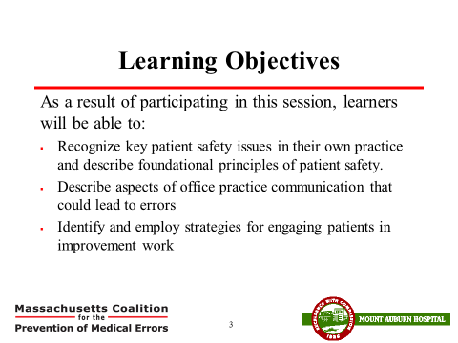
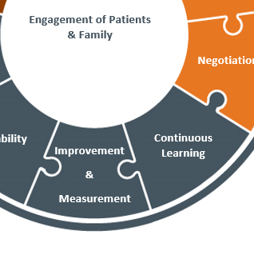
Focus on Improvement, Measurement and Continuous Learning

Slide 7
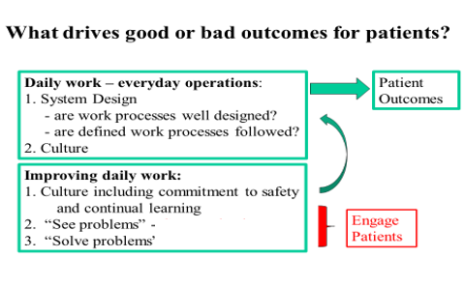
Your Theory of Outcomes

Slide 8
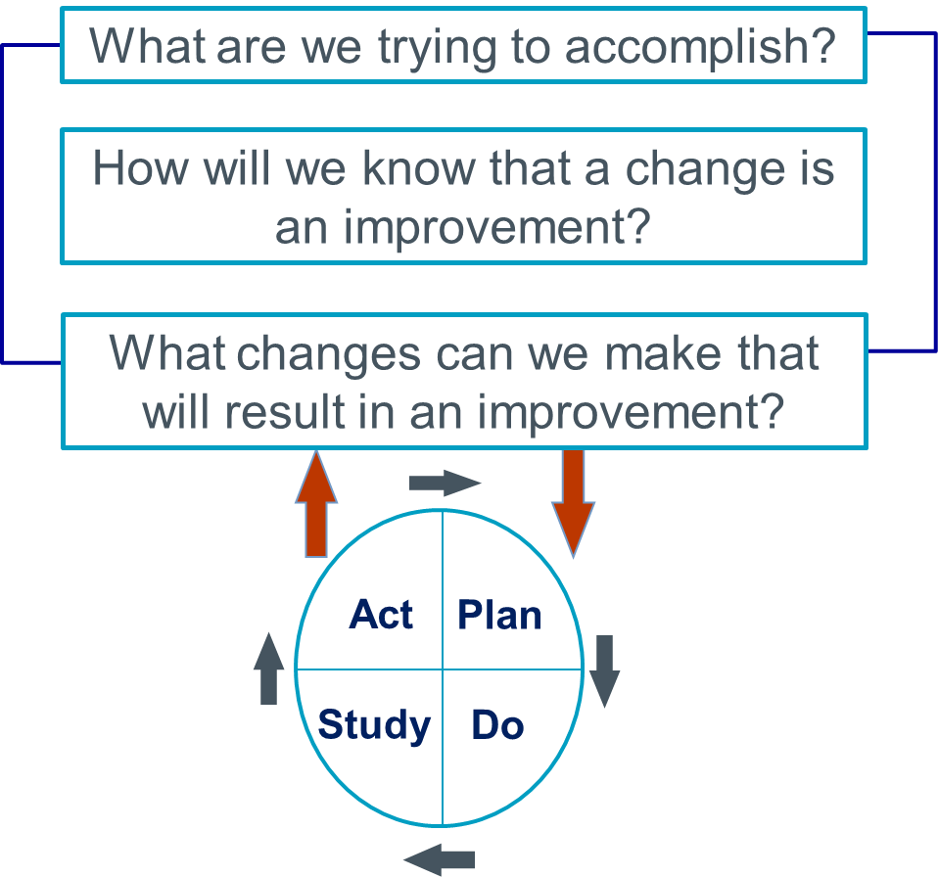
Model for Improvement
Notes:
Nolan’s model--three questions and PDSA, b but not just one PDSA. Difference between this and Juran is the emphasis on repeated PDSA cycles

Slide 9
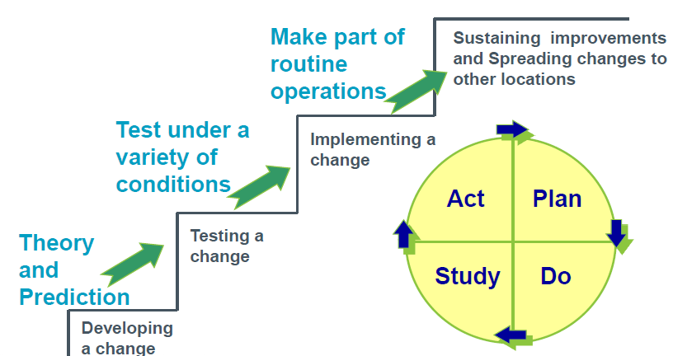
Building a Process for Sustainability

Slide 10

Congratulations
You are now an everyday Improver – Improving your work, while doing your work.

Slide 11

Activity Time

Slide 12

Discussion
What are the important actions that you are doing now that will be essential to keep doing?
What is going to trip you up?
And
How can you mitigate those barriers?

Slide 13

Reasons Why Improvement Fails
Poor implementation planning and overly aggressive timelines
Failing to create buy-in/ownership of the initiative
Ineffective leadership and lack of trust in upper management
Failing to create a realistic plan or improvement process
Ineffective and top-down communications
A weak case for change, unclear focus, and unclear desired outcomes
Little or no teamwork or cooperation
Failing to provide ongoing measurement, feedback, and accountability
Unclear roles, goals, and performance expectations
Lack of time, resources, and upper-management support
Staff turnover
Large new initiatives/organizational changes
http://au621leadershipvsmanagement.
Notes:
Why does see a problem solve a problem not work? What is going to trip you up?

